Slide 1
Section 5.5 Solving Systems with Absolute Values

Slide 2
The Absolute Value of a Function:
When we take the absolute value of a function, we are changing the Y-coordinates of a function, where if it is negative, it becomes positive
If the point has a negative y-coordinate in the original function, the coordinate in the abs function will have a positive y-coordinate
If the original point has a positive y-coordinate, then it doesn’t change
NOTE: X-coordinates DO NOT change. Only the Y-coordinates!!!

Slide 3
Graphs of Absolute Value functions:
y
y
y
6
6
6
4
4
4
2
2
2
x
x
x
-10
-8
-6
-4
-2
0
2
4
6
-10
-8
-6
-4
-2
0
2
4
6
-10
-8
-6
-4
-2
0
2
4
6
-2
-2
-2
y
y
y
6
6
6
4
4
4
2
2
2
x
x
x
-10
-8
-6
-4
-2
0
2
4
6
-10
-8
-6
-4
-2
0
2
4
6
-10
-8
-6
-4
-2
0
2
4
6
-2
-2
-2

Slide 4
II) The Two Sides of an Absolute Value graph
When solving equations with an absolute value, it will become two separate equations, one for each side of the ABS
First we graph the original line inside the ABS function
We then take the ABS of this linear function. Any point with a negative Y-coordinate will be reflected above the X-axis
Next we graph the constant on the right side of the equation
y
5
When solving the equation, we need to SPLIT the equation into TWO parts: LEFT & RIGHT
The left side was never reflected, so we use the original equation inside the ABS
4
3
2
This is the right side of the equation, since it was reflected, we place a negative sign in front of the equation
1
x
-4
-3
-2
-1
0
1
2
3
4
5
6
7
-1
These will be the two equations you solve for each side
-2
-3
-4
The objective is to find the “X” coordinates of these intersection points
-5

Slide 5
II) Solving Absolute Value Equations
Isolate the ABS function
Look for intersection on both sides of the ABS
Check for Extraneous Roots
y
6
4
2
x
-10
-8
-6
-4
-2
0
2
4
6
-2
The solutions are: x= -8 & x= 2

Slide 6
Practice: Solve
No Solutions
Extraneous Root
Solution is at x = 0
Solution is at x = 1.666

Slide 7
Practice: Solve
Graph the equation after the abs is isolated and simplified…
y
y
6
6
4
4
2
2
x
x
-3
-2
-1
0
1
2
3
4
5
6
-3
-2
-1
0
1
2
3
4
5
6
-2
-2
Extraneous
Root
Only one intersection at x=0
Only one intersection at x=1.66

Slide 8
How to Solve Equations With Multiple ABS
There are two ways to solve equations when there are multiple absolute values
First method: Algebraic Approach with Separate Cases
For each absolute value, there will be two possibilities: “positive” or “negative”
So if there are two ABS, we will have FOUR cases:
Solve all FOUR of these cases, get the answer, plug it back in to check if they are extraneous roots
If there are three ABS, you will then have 8 cases!
Case 1
Case 1
Case 2
Case 2
Case 3
Case 4
Case 3
Case 5
Case 6
Case 4
Case 7
Case 8

Slide 9
Since there are two absolute values, we need to consider all four cases with each abs value being positive or negative
For cases with solutions, check them by plugging it back in to the original equation
Case 1
Case 4
Case 2
Case 3
Case 4
No Solutions
Solution is good!
Solution is good!
No Solutions

Slide 10
Since there are two absolute values, we need to consider all four cases with each abs being positive or negative
Check each solution by plugging it back in
Therefore, the solutions to the system will be x = 2 and x = -1.333
Case 1
Case 2
Case 3
Case 4
Solution!
Extraneous
Extraneous
Solution!

Slide 11
Check each value of “x” by plugging it back into the equation
The solution to this equation is:
x=2.75 and x= –2.25

Slide 12
2nd Method: Graphical Approach
Treat the left side of the equation with all the ABS as a function
Find the x-intercepts from each absolute value, plug each one in separately to find the y-value of the equation [get the height of graph]
Connect these dots to get an idea of how this function will look:
y
8
Intersection point will also be on the RIGHT side!!
4
The intersection points will be on the LEFT side
x
-3
-2
-1
0
1
2
3
4
5
6
7
-2

Slide 13
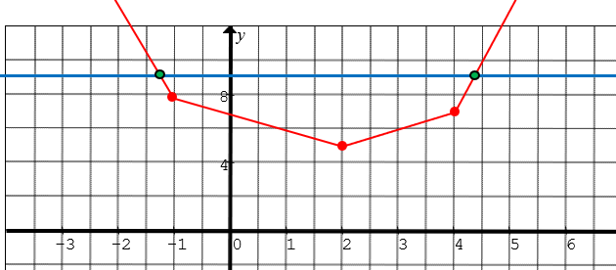
The second part of the method requires determining if the ABS in equation is either positive or negative
This depends on whether if the intersection points are either on the LEFT or RIGHT of the ABS
If the intersection is in this domain, then ALL three absolute values will be NEGATIVE, b/c it will all need to pointing the NEGATIVE side!!!

Slide 14
The second part of the method requires determining if the ABS in equation is either positive or negative
This depends on whether if the intersection points are either on the LEFT or RIGHT of the ABS
If the intersection is in this domain, the first one is positive and the other two are NEGATIVE. Use the arrows to decide if it is positive or negative!

Slide 15
The second part of the method requires determining if the ABS in equation is either positive or negative
This depends on whether if the intersection points are either on the LEFT or RIGHT of the ABS
If the intersection is in this domain, the first and second ABS are positive and the last one is NEGATIVE. Use the arrows to decide if it is positive or negative!

Slide 16
The second part of the method requires determining if the ABS in equation is either positive or negative
This depends on whether if the intersection points are either on the LEFT or RIGHT of the ABS
If the intersection is in this domain, All THREE ABS Values will be POSITIVE b/c they will point to the RIGHT!!!

Slide 17
Since the intersections are in the FAR left and Far right domains, then you will only need to solve these two equations:

Slide 18
Suppose we have a different equation that is slightly more complicated:
First thing we do is find the x-intercept of each abs component, then rearrange the equation by the value of the x-intercept
So I would rewrite my equation to make it easier to visualize the graph:
Smallest
Largest
Largest
The right side of the equation is y=4
Middle
Smallest
So the intersection is Q1
Now plug in each x-intercept and find the y-values. This is to get the graph of the function with 3 abs values!!!
y
4
2
x
-3
-2
-1
0
1
2
3
4
5
6
7
-2

Slide 19
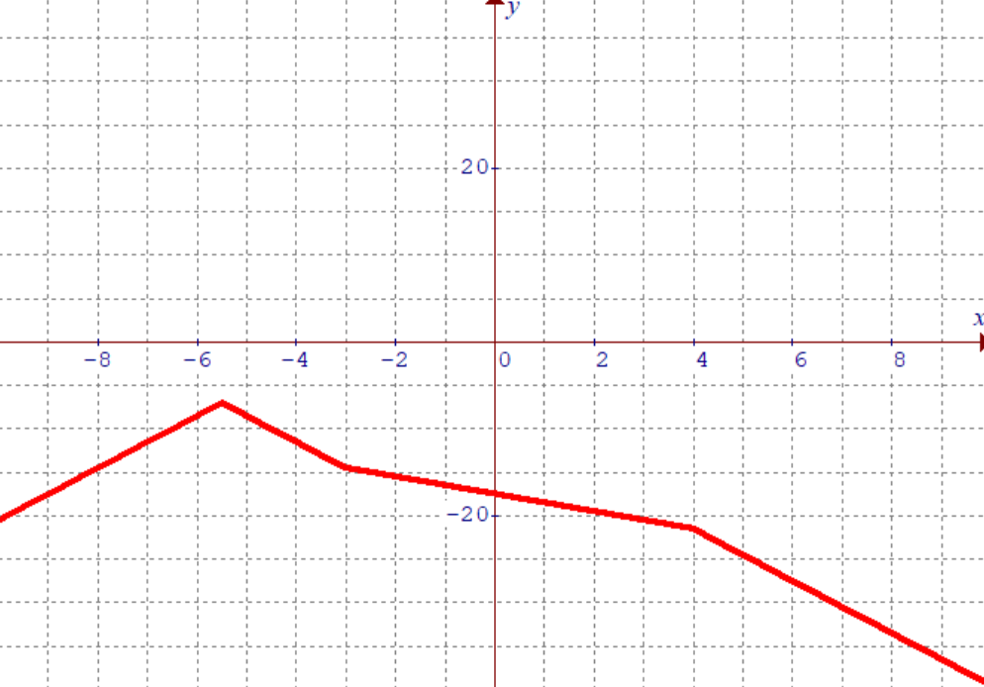
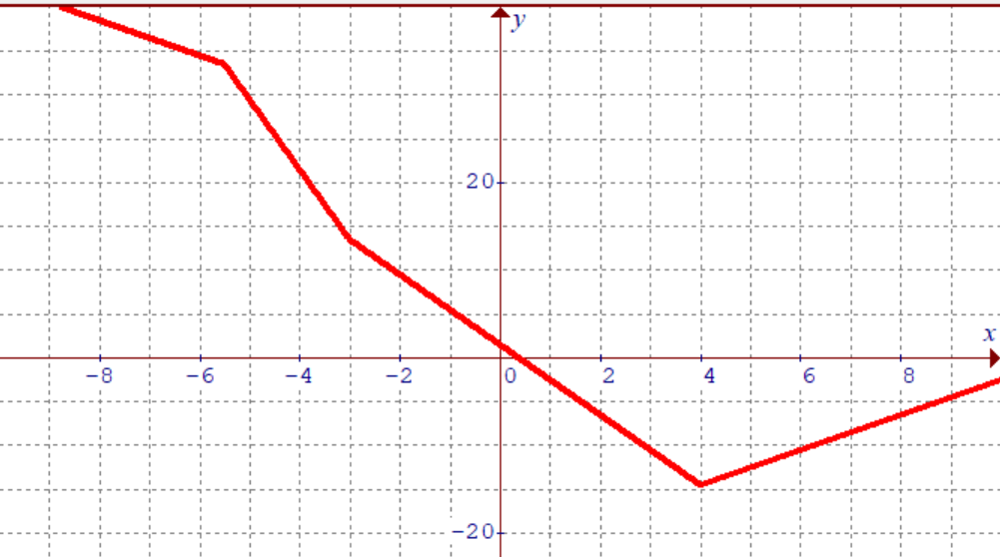
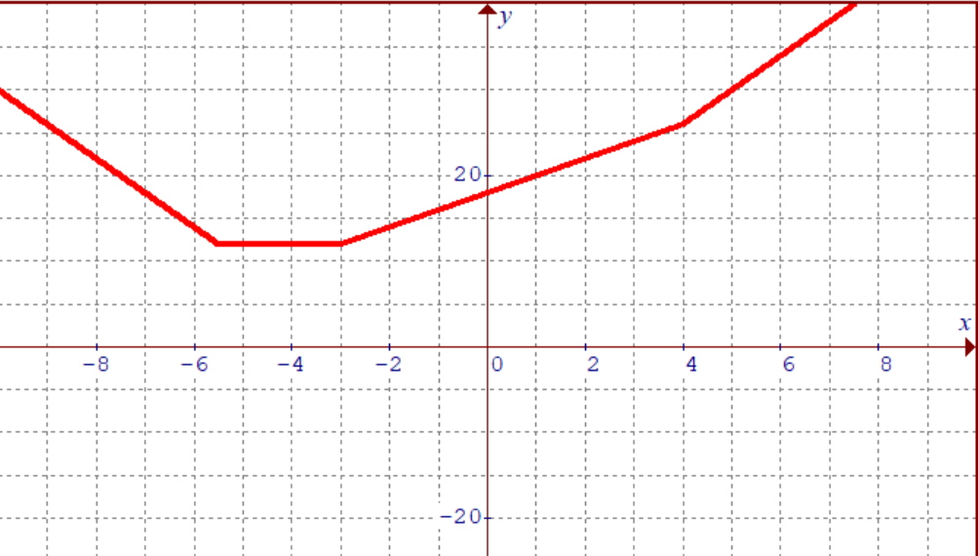
Ex: Graph each function and then match it with the corresponding graph

Slide 20
Practice: Solve the following equations:

Slide 21
IV) Solving Abs. Values With Inequalities:
Graph the absolute value and then find all the intersection points
Use the inequality to determine if you want the Top or Bottom side of the equation:
Select the domain that satisfies your inequality:
Find the height of the graph at where each ABS is equal to zero
Get the y-values at each of these points:

Slide 22
Find Intersection Points
Number Line → Test Points

Slide 23
Q3: What are all real numbers “x” for which the inequality is true?
Q1: Practice: Solve the inequality
Q2: For what values of ‘k” will there be no solutions:

Slide 24
What are all real numbers “x” for which the inequality is true?
Before we solve the inequality, solve the equation first
Simplify each equation by isolating the absolute value
The first case has no solutions
The second case will have 2 solutions
Draw a number line with the two solutions
Plug numbers into the equation to see where the solution is

Slide 25
What are all real numbers “x” for which the inequality is true?
Use a graphical approach and break the equation down in steps:
The left side is an ABS graph:
If we place a negative sign in front, the graph will go through a vertical reflection:
If you add 5 to the equation on the left, it will go UP by 5 units!
If you take the ABS value of the left side again, it will reflect everything underneath the X-axis and move it above
Find the intersection algebraically, and we know that answer will be in between!

Slide 26
V) Solving Absolute Value Inequalities
Solve for all intersections points
Number Line → Test Points
Check which Domain satisfies the inequality
Solve for Intersections points
Make a number Line
Create Test Points
Only one region satisfy the inequality

Slide 27
Practice: Solve the inequalities
Extraneous Root
b/c right side will be negative
Soln.
Soln.

Slide 28
Challenge:
No Solution!
Both sides of the number line yield no solutions. So the only point that satisfies the inequality is at x = 2
Both sides are true, except at the intersection point. So the solution will be everything but x=1

Slide 29
VI) Solving Equations with 2 Abs. Values
Each absolute value can be either positive or negative
Consider all four cases ++, + – , – +, – –
Check which Domain satisfies the inequality
The solutions/intersections are at x= –3.5, x=5.5

Slide 30
Check each value of “x” by plugging it back into the equation
The solution to this equation is:
x=2 and x= –1.333

Slide 31
Check each value of “x” by plugging it back into the equation
The solution to this equation is:
x=2.75 and x= –1.5

